Slide 1
Software Development with UML and Java 2
Remote Method Invocation

Slide 2
Advisory board
2 students per class
Give feedback to the school, circumstances, conditions, atmosphere
Wednesday, 30th of October
Write me an email, if you’re interested

Slide 3
General assignment feedback

Slide 4
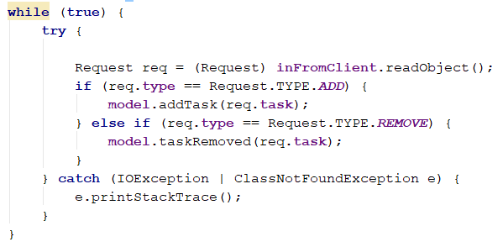
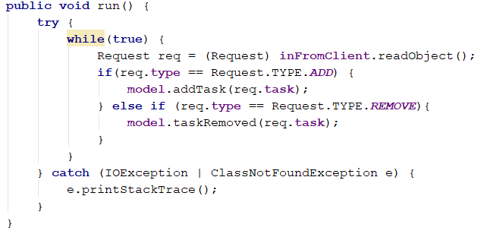
Try-catch outside of while loop

Slide 5
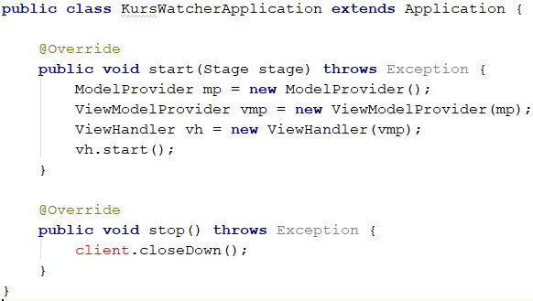
Graceful shutdown
Have the client send a message to the server, so it will break out of the while loop, where objects are read

Slide 6
Package structure
client
server
shared

Slide 7
Package structure
Client shouldn’t import anything from the server, and this structure makes it easier to see, when you’re messing up
client
view
viewmodel
model
networking
server
model
networking
shared
util
datatransferobject

Slide 8
Too ambitious
Planning way too many features
Thinking you have time to implement them all

Slide 9

Critical parts
Just working on the GUI until the last minute, and then thinking it’s quick to slap on some networking.

Slide 10
Focused work
Listen to Scrum
Focus on finishing one feature at a time.
It’s a lot better to have 50% of the requirements 100% done, rather than 100% of the requirements 50% done.
Focus on just what you need to progress. Careful not to do irrelevant work, which you “may need later”

Slide 11
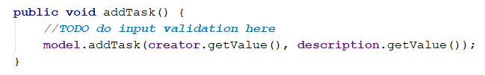
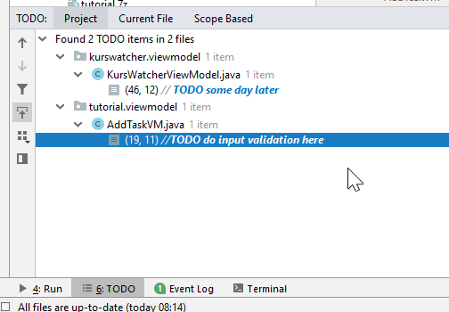
Intellij has a built in todo-list, it’s useful

Slide 12
As a user I can log in
Arbitrary, unique username
Between 3 and 14 characters
As a user I can see who is online
As a user, when I log in, others can see it in their list
As a user, when I log out, others will see me disappear from their list
As a user, I can chat in the general chat
As a user, I can select another user to private chat with
As a user, if someone sends me a message, a new chat window will open
As a user, I can send a meme to another user

Slide 13
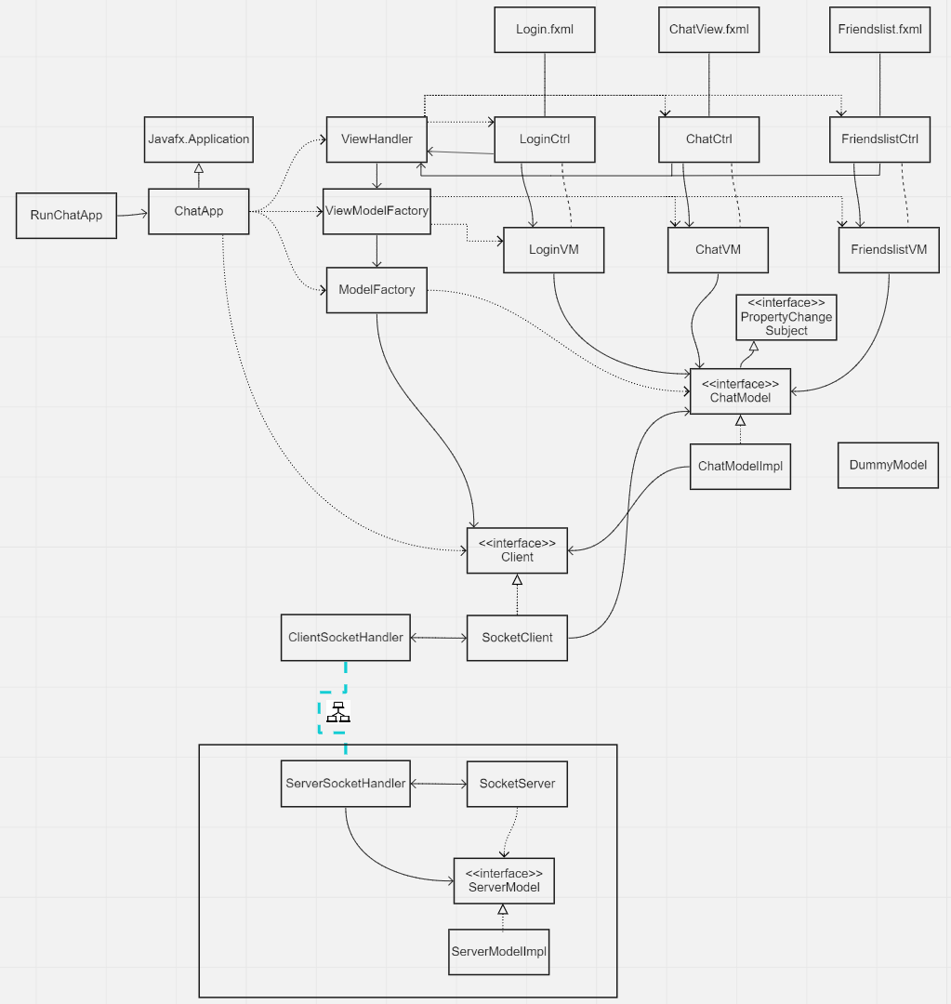
As a user I can log in
Opens nothing
Start with the MVVM “Core”
Creates nothing
Creates nothing

Slide 14
As a user I can log in
Expand with basic view

Slide 15
As a user I can log in
Opens Login
Add a controller
Add a button action, run the program and verify you can print something out, when the login button is pressed
Creates nothing
Creates nothing

Slide 16
As a user I can log in
Add VM
Verify that you can make the bindings, and that the VM prints out your login credentials, when the Login button is pressed
Creates VM now
Creates nothing

Slide 17
As a user I can log in
Add Model
Verify that can print out login credentials from the model. Could create a dummy method, which simulates a successful login, and propagate the response back to the view/controller, which will then print out “log in successful”

Slide 18
As a user I can log in
Add client/server
Verify that you can send the login credentials to the server, and get a response back.
You could hardcode a user.
You should now have the login functionality in place.

Slide 19
As a user I can log in
Move on to next requirement, same approach

Slide 20
Who knows about the ViewHandler?
MVVM (and MVC and MVP) have this structure to ease testing.
View
ViewHandler
?
VM
M

Slide 21
Who knows about the ViewHandler?
MVVM (and MVC and MVP) have this structure to ease testing.
View
ViewHandler
Unit test class
VM
M

Slide 22
Who knows about the ViewHandler?
View
ViewHandler
Code that tests your code. Automated tests.
Unit test class
VM
M

Slide 23
Who knows about the ViewHandler?
View
ViewHandler
A lot more difficult, if you’re depending on some “View” stuff.
Unit test class
Unit test class
ViewHandler
VM
VM
M
M

Slide 24
Who knows about the ViewHandler?
View
ViewHandler
Maybe not relevant for you
Unit test class
Unit test class
ViewHandler
VM
VM
M
M
Dummy client

Slide 25


Slide 26
Remote Method Invocation

Slide 27
Client
Server
Sockets
Client
Server
RMI

Slide 28


RMI
What is the purpose of RMI?
To instantiate objects and invoke methods on these objects when the objects are located on a remote computer
To make the method invocation somewhat transparent to whether the objects are local objects or remote objects
Server serv = new Server()
Server serv = registry.lookup(“server”);
String data = serv.getSomeData();

Slide 29
RMI
Instead of having specific socket classes, you define your own objects, and then “add a detail” so that this object “exists” on both client and server. If you then call a method on the object on the client side, that method is actually called on the object on the server side.

Slide 30
RMI
What is RMI?
RMI gives a higher abstraction level with the use of TCP connections and communication hidden from the programmer
Client and server must both be written in Java
The good part: we don’t really need to worry about explicit Threads.

Slide 31
Client
Server
Sockets
CSocketHandler
SSocketHandler
RMI
Client
Server
CSocketHandler
SSocketHandler

Slide 32
Client
Server
Sockets
CSocketHandler
SSocketHandler
How we use it
RMI
Client
Server
CSocketHandler
SSocketHandler

Slide 33

First some concepts
For sockets, to make the connection, we..:
Created a ServerSocket
Client connected with a Socket
Server created a Socket when the client connected
We would create socket handler threads.
We can now use these two sockets to communicate
Client
Socket
Server

Slide 34
Client computer
Server computer
Server
Program
Client
Program
The basic setup to run server and connect to it

Slide 35

Client computer
Server computer
Server
Program
Server Main method creates registry, a kind of separate program now running on the same machine
Client
Program
Registry
Server main method starts
Instantiate server object
Put that object in the registry
Client main starts
Instantiate client object
Client object contacts registry
Client object receives instance of server stub from registry
Client object can now call methods on server object (remotely)
This is a local “representation” of the server

Slide 36


Slide 37
Example
Adding messages from the Client to a list on the Server

Slide 38
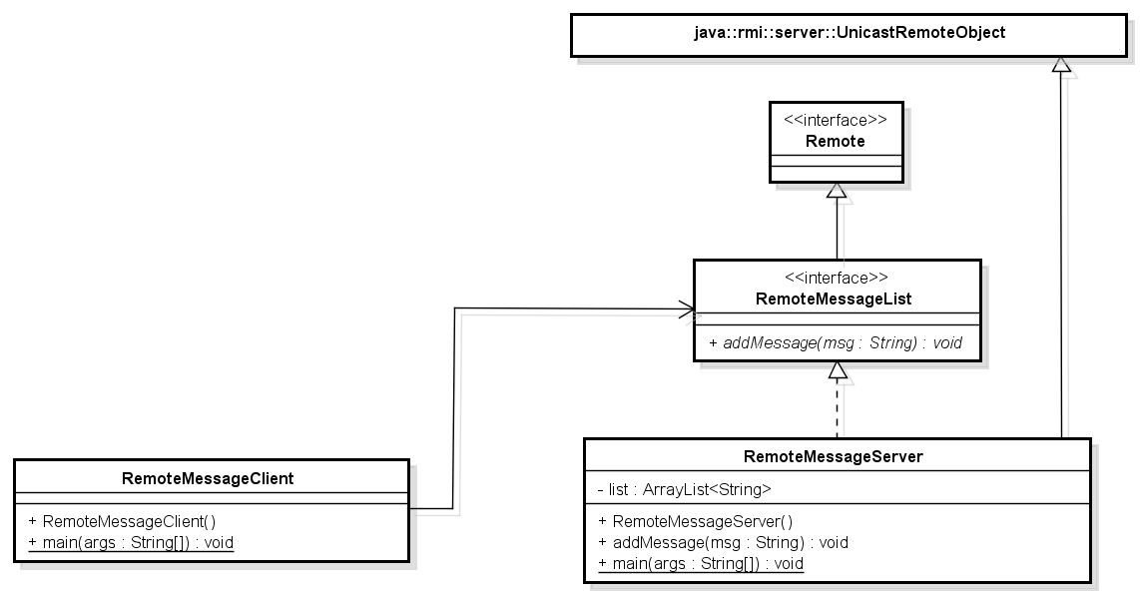
RMI example
Notice. Exists in Java
Interface/Stub method
throws RemoteException
Server side
Client side
Notes:
When the server starts, it puts itself in the registry. The client uses the registry to get the server object.
addMessage is void, but can also return a Serializable object.

Slide 39
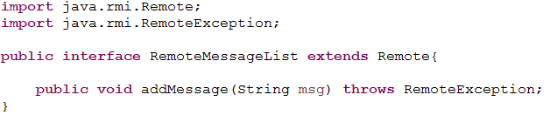
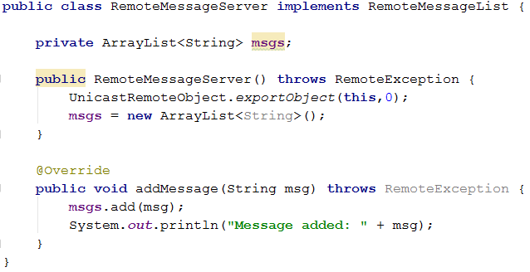
Remember this!
Methods here can also return something.
The return type must implement the Serializable interface

Slide 40
Implement interface
Server is exported, available to receive incoming calls.
Can be put in the registry

Slide 41
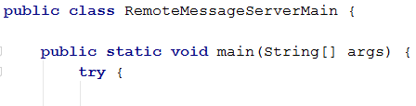
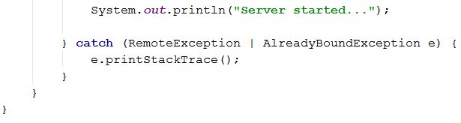

Slide 42
This is what is required to run the server
1. We create the registry, i.e. the phonebook. Port 1099
2. Instantiate the server, as the type of the interface
3. Put the server instance into the registry, give it a name
4. The name can be anything. Think of it like a map: pairs of key & value.
“msgList” is the key, the server instance is the value.

Slide 44
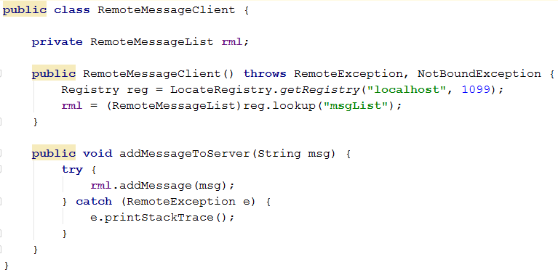
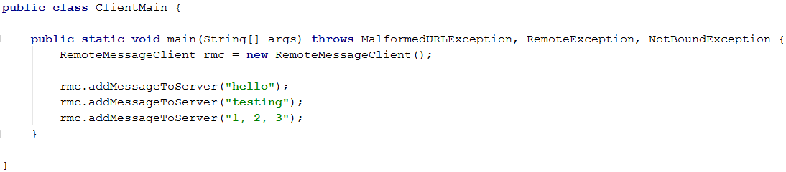
Client
Stub. The interface representing the server
Get registry located at…
Retrieve server stub

Slide 45
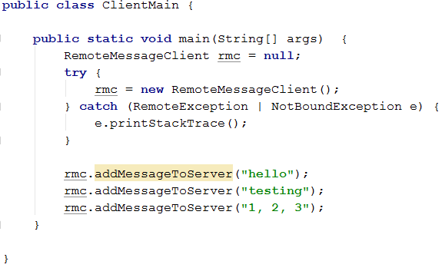
Client Main

Slide 46


Slide 47
Demonstration

Slide 48
Steps
Server must implement a special interface.
All methods in this interface are defined: throws RemoteException
The interface extends Remote
The Server must have a constructor in which it exports UnicastRemoteObject
Starting the server
Create registry
Create server instance, defined as the type of its interface
Add server to registry
Client looks up the server in the registry and receives an instance.

Slide 49

Steps
Server must implement a special interface.
All methods in this interface are defined: throws RemoteException
The interface extends Remote
The Server must have a construct in which it exports UnicastRemoteObject
Starting the server
Create registry
Create server instance
Add server to registry
Client looks up the server in the registry and receives an instance.

Slide 50
So now the client can call methods on the server.
Void methods
Or methods can return values/data.
What if the server wants to call methods on the client, instead of just returning values? I.e. an active push, similar to when the server sent out chat messages when we used sockets.

Slide 51
Previous setup
Server side
Client side
Notes:
When the server starts, it puts itself in the registry. The client uses the registry to get the server object.
addMessage is void, but can also return a Serializable object.

Slide 52
We want the server to say thank you back to the client
This should be a call on the Client, not just a return value.

Slide 53
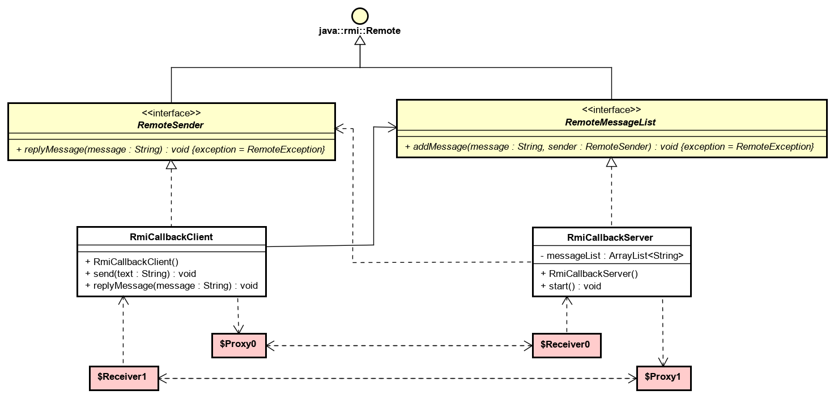
RMI callback, the server calls methods on the client

Slide 54
RMI callback, the server calls methods on the client

Slide 55
RMI callback, the server calls methods on the client
rML.addMessage(“hello”, this);
sender.replyMessage(“Thank you”);

Slide 56
The Server can call methods on the Client
The client must implement an interface
This interface must extend Remote
Methods defined in this interface is available to the Server
The Client must at some point send itself to the Server

Slide 57
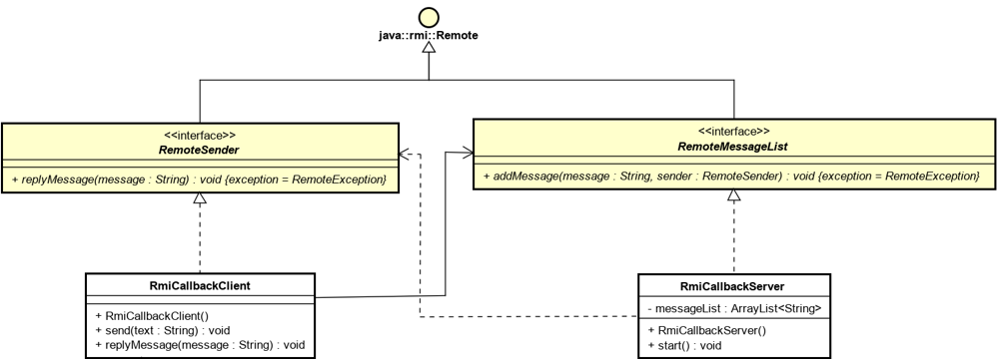

Slide 58
public interface ReplyTo extends Remote { void replyMessage(String msg) throws RemoteException; }
public interface RemoteMessageList extends Remote { void addMessage(String msg, ReplyTo who) throws RemoteException; }
public class RemoteMessageClient implements ReplyTo { private RemoteMessageList rml; public RemoteMessageClient() throws RemoteException { UnicastRemoteObject.exportObject(this, 0); Registry registry = LocateRegistry.getRegistry("localhost", 1099); try { rml = (RemoteMessageList) registry.lookup("RML"); } catch (NotBoundException e) { e.printStackTrace(); } } public void addMessage(String msg) { try { rml.addMessage(msg, this); } catch (RemoteException e) { e.printStackTrace(); } } @Override public void replyMessage(String msg) throws RemoteException { System.out.println(msg); } }
public class RemoteMessageServer implements RemoteMessageList { List<String> msgs; public RemoteMessageServer() throws RemoteException { UnicastRemoteObject.exportObject(this, 0); msgs = new ArrayList<>(); } @Override public void addMessage(String msg, ReplyTo who) throws RemoteException { msgs.add(msg); who.replyMessage("Thank you for the message"); } }

Slide 59
public interface ReplyTo extends Remote { void replyMessage(String msg) throws RemoteException; }
public interface RemoteMessageList extends Remote { void addMessage(String msg, ReplyTo who) throws RemoteException; }
public class RemoteMessageClient implements ReplyTo { private RemoteMessageList rml; public RemoteMessageClient() throws RemoteException { UnicastRemoteObject.exportObject(this, 0); Registry registry = LocateRegistry.getRegistry("localhost", 1099); try { rml = (RemoteMessageList) registry.lookup("RML"); } catch (NotBoundException e) { e.printStackTrace(); } } public void addMessage(String msg) { try { rml.addMessage(msg, this); } catch (RemoteException e) { e.printStackTrace(); } } @Override public void replyMessage(String msg) throws RemoteException { System.out.println(msg); } }
public class RemoteMessageServer implements RemoteMessageList { List<String> msgs; public RemoteMessageServer() throws RemoteException { UnicastRemoteObject.exportObject(this, 0); msgs = new ArrayList<>(); } @Override public void addMessage(String msg, ReplyTo who) throws RemoteException { msgs.add(msg); who.replyMessage("Thank you for the message"); } }

Slide 60
public interface ReplyTo extends Remote { void replyMessage(String msg) throws RemoteException; }
public interface RemoteMessageList extends Remote { void addMessage(String msg, ReplyTo who) throws RemoteException; }
public class RemoteMessageClient implements ReplyTo { private RemoteMessageList rml; public RemoteMessageClient() throws RemoteException { UnicastRemoteObject.exportObject(this, 0); Registry registry = LocateRegistry.getRegistry("localhost", 1099); try { rml = (RemoteMessageList) registry.lookup("RML"); } catch (NotBoundException e) { e.printStackTrace(); } } public void addMessage(String msg) { try { rml.addMessage(msg, this); } catch (RemoteException e) { e.printStackTrace(); } } @Override public void replyMessage(String msg) throws RemoteException { System.out.println(msg); } }
public class RemoteMessageServer implements RemoteMessageList { List<String> msgs; public RemoteMessageServer() throws RemoteException { UnicastRemoteObject.exportObject(this, 0); msgs = new ArrayList<>(); } @Override public void addMessage(String msg, ReplyTo who) throws RemoteException { msgs.add(msg); who.replyMessage("Thank you for the message"); } }

Slide 61
public interface ReplyTo extends Remote { void replyMessage(String msg) throws RemoteException; }
public interface RemoteMessageList extends Remote { void addMessage(String msg, ReplyTo who) throws RemoteException; }
public class RemoteMessageClient implements ReplyTo { private RemoteMessageList rml; public RemoteMessageClient() throws RemoteException { UnicastRemoteObject.exportObject(this, 0); Registry registry = LocateRegistry.getRegistry("localhost", 1099); try { rml = (RemoteMessageList) registry.lookup("RML"); } catch (NotBoundException e) { e.printStackTrace(); } } public void addMessage(String msg) { try { rml.addMessage(msg, this); } catch (RemoteException e) { e.printStackTrace(); } } @Override public void replyMessage(String msg) throws RemoteException { System.out.println(msg); } }
public class RemoteMessageServer implements RemoteMessageList { List<String> msgs; public RemoteMessageServer() throws RemoteException { UnicastRemoteObject.exportObject(this, 0); msgs = new ArrayList<>(); } @Override public void addMessage(String msg, ReplyTo who) throws RemoteException { msgs.add(msg); who.replyMessage("Thank you for the message"); } }

Slide 62
public interface ReplyTo extends Remote { void replyMessage(String msg) throws RemoteException; }
public interface RemoteMessageList extends Remote { void addMessage(String msg, ReplyTo who) throws RemoteException; }
public class RemoteMessageClient implements ReplyTo { private RemoteMessageList rml; public RemoteMessageClient() throws RemoteException { UnicastRemoteObject.exportObject(this, 0); Registry registry = LocateRegistry.getRegistry("localhost", 1099); try { rml = (RemoteMessageList) registry.lookup("RML"); } catch (NotBoundException e) { e.printStackTrace(); } } public void addMessage(String msg) { try { rml.addMessage(msg, this); } catch (RemoteException e) { e.printStackTrace(); } } @Override public void replyMessage(String msg) throws RemoteException { System.out.println(msg); } }
public class RemoteMessageServer implements RemoteMessageList { List<String> msgs; public RemoteMessageServer() throws RemoteException { UnicastRemoteObject.exportObject(this, 0); msgs = new ArrayList<>(); } @Override public void addMessage(String msg, ReplyTo who) throws RemoteException { msgs.add(msg); who.replyMessage("Thank you for the message"); } }

Slide 63


Slide 64
Initialization
Often you initially register one object in the registry.
Through this object, other serializable objects/stubs can be returned to the client.
Notes:
The stub is an interface extending Remote.

Slide 65
Client
Server
Sockets
Sockets: One “Bridge”
RMI: Multiple “Bridges”
Client
Server
RMI
PersonData
PersonData and CustomerData must both implement an interface, which extends Remote. The Client can call the Server, and request the other objects
CustomerData

Slide 66
Return values / values to send over network
Remote objects (implements Remote) and non-remote objects
Remote objects are stubs/interfaces. These represent a link between server and client: remote references to an object on the server.
Non-remote objects implements Serializable. The server instantiates such an object, and the client receives it. Just containers for data. Like our Request class, we have used before.

Slide 67


Slide 68
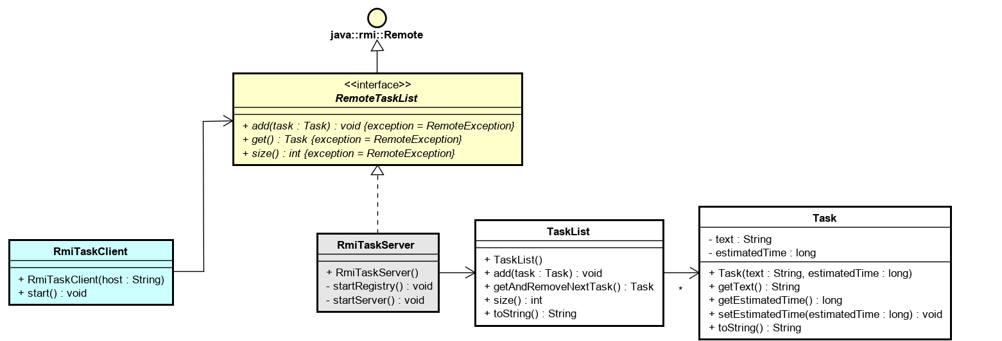

Dynamic class downloading
Client side (RmiTaskClient, RemoteTaskList, Task)
What about SignedTask?

Slide 69
Dynamic class downloading
java.rmi.UnmarshalException: error unmarshalling return; nested exception is:
java.lang.ClassNotFoundException: model.SignedTask
at java.rmi/sun.rmi.server.UnicastRef.invoke(UnicastRef.java:194)
…

Slide 70
Security – main method
When you want to connect a computer to a different computer, you need to specify a security file, client side.
public static void main(String[] args) throws RemoteException
{
System.setProperty(“java.security.policy”, “security.policy”);
if (System.getSecurityManager() == null)
{
System.setSecurityManager(new RMISecurityManager());
}
RmiClient client = new RmiClient();
}
Sometimes you need absolute path here

Slide 71
Security
You can put specific stuff
rmi.policy
grant {
permission java.net.SocketPermission "*:1024-65535", "connect,accept";
permission java.net.SocketPermission "*:80", "connect";
};
all.policy
grant {
permission java.security.AllPermission;
};
File name
Put in file
You should just give all access for now
Notes:
rmi.policy is a file.

Slide 72
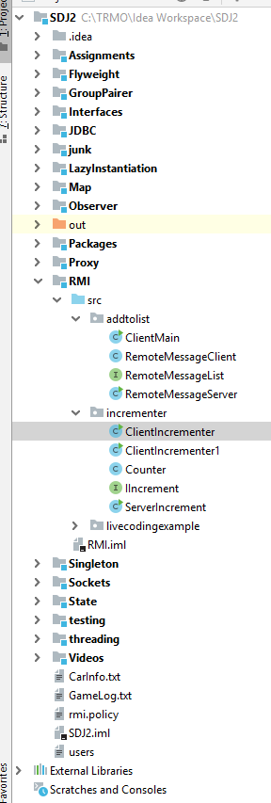
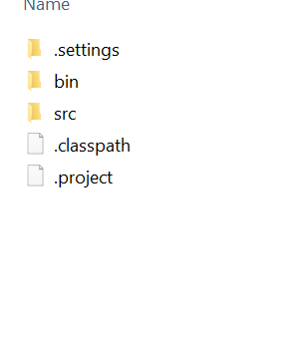
Security
Place the security file in the root of your project
Here

Slide 73
Security
Probably not needed for the exercises
Needed for your projects to connect two computers

Slide 74


Slide 75
RMI sum up / check-list
Objects, which are invoked remotely, needs:
UnicastRemoteObject.exportObject(this, 0) in the constructor
A constructor, which throws RemoteException
Implement an interface which extends Remote.
All methods in interface must be declared “throws RemoteException”
Return values in Remote interfaces either:
Implements a Remote interface
Implements Serializable

Slide 76
Sockets versus RMI
Client
Client
Server
Server
No apparent threads. Hidden from us
Different thread
Notes:
Socket often use “asynchronous callbacks”, i.e. the return from the server is delivered to another method/other class, which runs in a thread. Otherwise you risk the program stalling, while waiting for the server to return.

Slide 77
Socket vs RMI
RMI is easier if it’s on the same network
Outside LAN, it requires all kinds of firewall and port setup.
Probably more intuitive, once you familiarize yourself.
Very much like your normal object-method-calling
Multiple “bridges” from client to server
Use sockets outside of LAN
Needs explicit threads
More connection-handling required by programmer
More difficult to set up client-server protocol
Single “bridged”, meaning you need to do a lot of if-else-if in the SocketHandler Thread

Slide 78


Slide 79
Who’s here

Slide 80
Exercises

